Slide 1

Cash Flow Statement Part 2 - Video

Slide 2
Goals:
Investing Activities
Financing Activities
Subsequent Events

Slide 3
What is a cash flow statement?
Financial statement that explains cash inflows and outflows over a period of time.
Operating Cash Inflows/Outflows
$$Cash_{Today} −Cash_{OneYearAgo}=$$
Investing Cash Inflows/Outflows
Financing Cash Inflows/Outflows

Slide 4
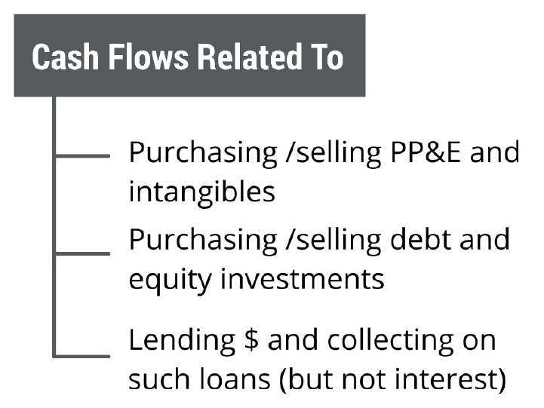
Investing Cash Flows

Slide 5
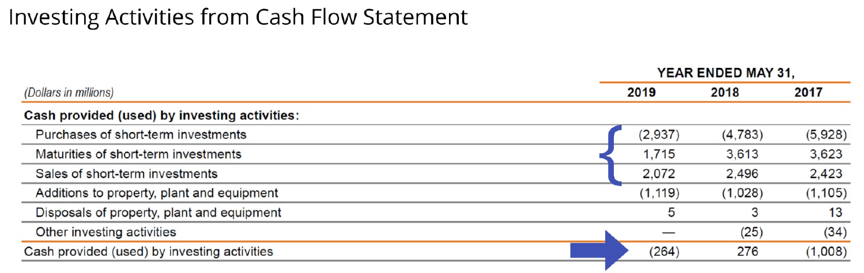
Nike (2019)

Slide 6
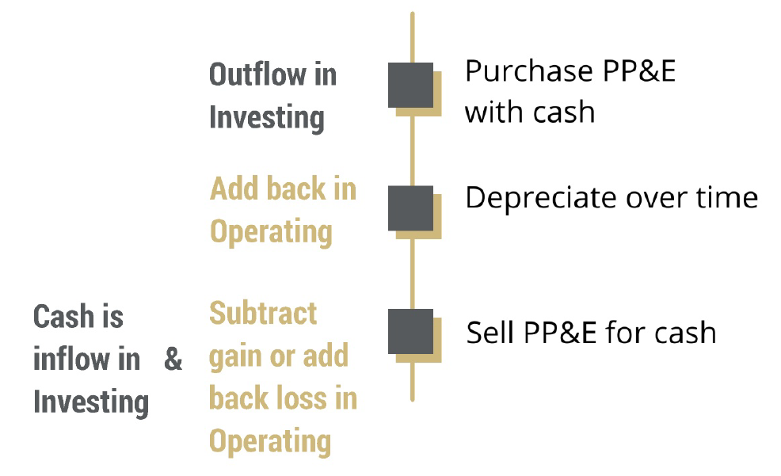
Investing: PP&E
Cash flows over the life of PP&E using the indirect method

Slide 7
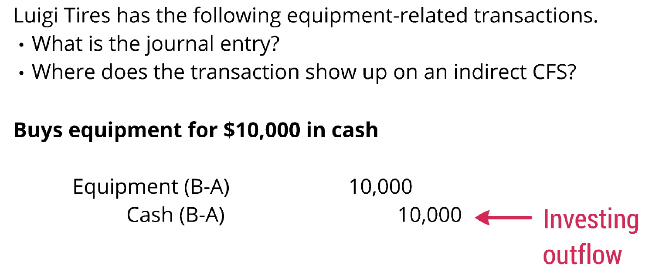
Investing: PP&E

Slide 8
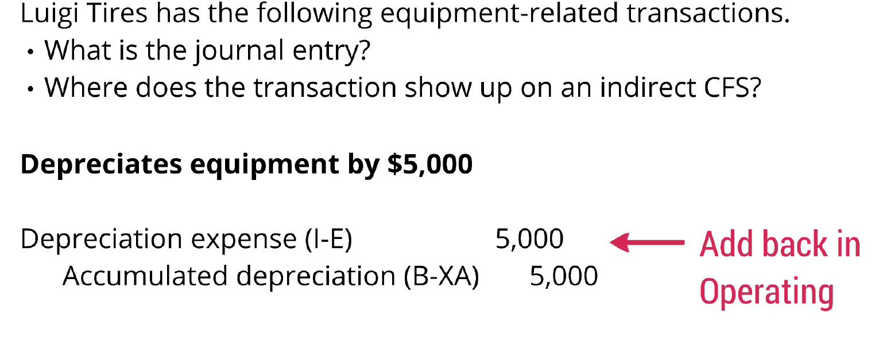
Investing: PP&E

Slide 9
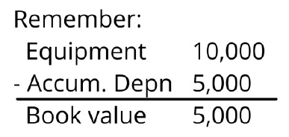
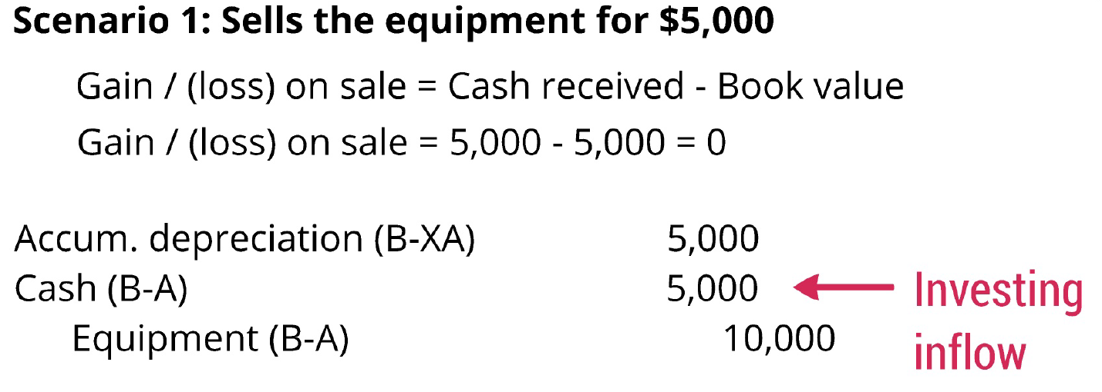
Investing: PP&E

Slide 10
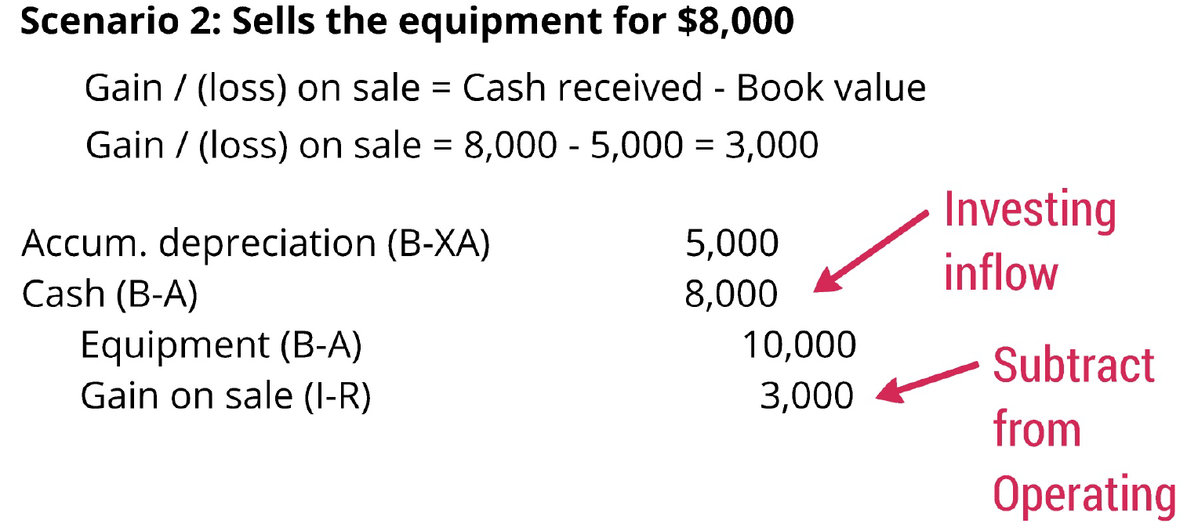
Investing: PP&E

Slide 11
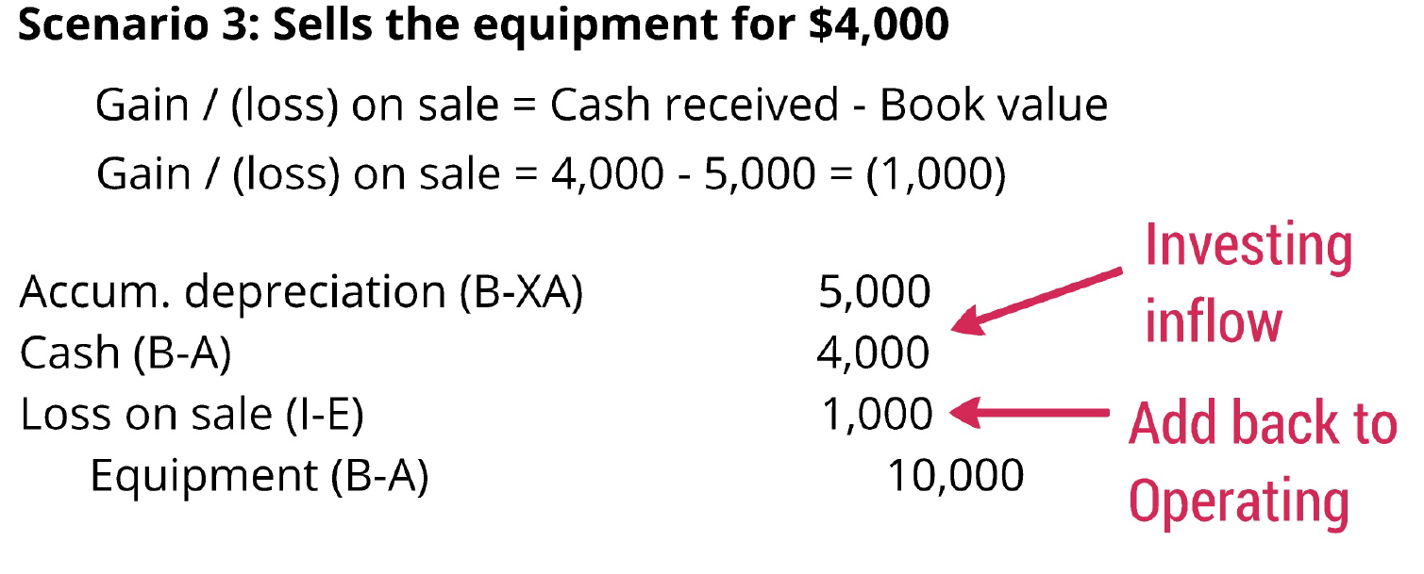
Investing: PP&E

Slide 12
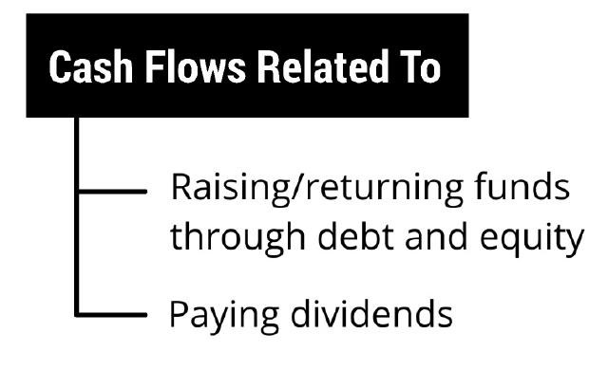
Financing Cash Flows

Slide 13
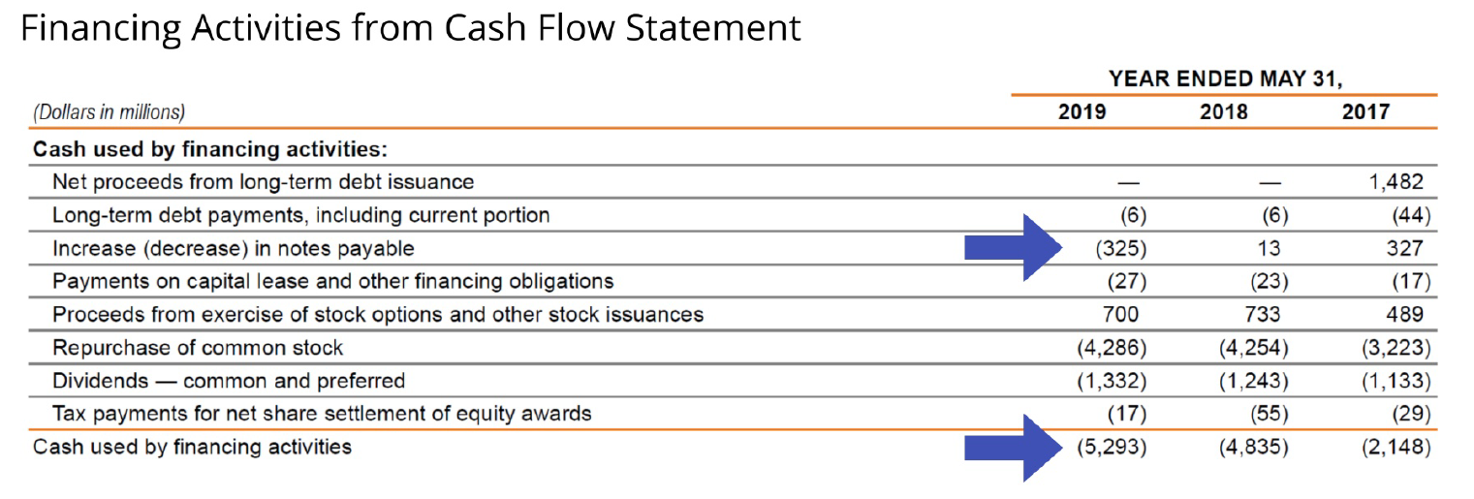
Nike (2019)

Slide 14
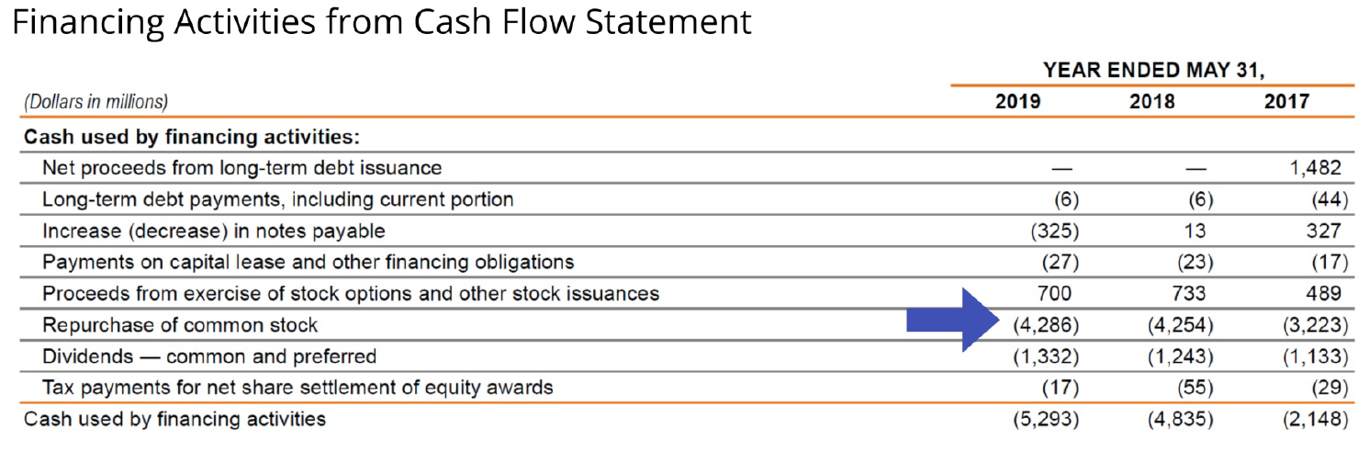
Nike (2019)

Slide 15
Subsequent Events
An event that occurs after the fiscal year-end (e.g., 12/31/2018) but before financial statements are issued (e.g. 3/1/2019).
Examples: sale of a business, issuance of debt or equity securities, settlement of litigation.
Possible accounting treatments:
Adjust numbers before releasing financials
Disclose the event in the footnotes, but not adjust

Slide 16
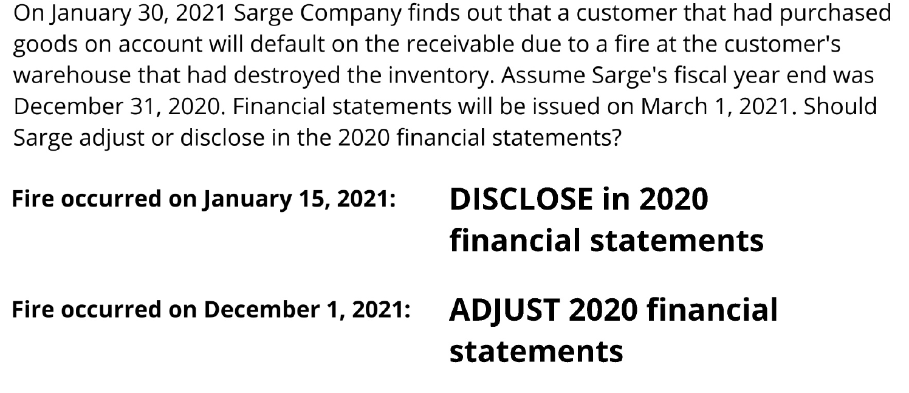
Subsequent Events
0

Slide 17
Closing Thoughts
Investing and financing sections show direct cash inflows and outflows
When selling PP&E, put all cash received in investing, back out the gain/loss from operating
Adjust/disclose subsequent events in F/S depending on whether there is a pre-existing condition

Slide 18
Cash Flow Statement Part 2 - Video

